Slide 1
Continuous Integration
(CI)
Prof. Dr. Dirk Riehle
Friedrich-Alexander University Erlangen-Nürnberg
ADAP Z02
Licensed under CC BY 4.0 International
Notes:
It is Friedrich-Alexander University Erlangen-Nürnberg – FAU, in short.
Corporate identity wants us to say “Friedrich-Alexander University”.

Slide 2


Daily Development Problems
What to do to integrate my code?
Is my code working?
If not: Where are problems?
So much work each time!!!!
Repository
Commit & push

Slide 3

Continuous Integration (CI)
“Continuous Integration is a software development practice where members of a team integrate their work frequently […] this approach leads to significantly reduced integration problems and allows a team to develop cohesive software more rapidly.” [1]
Repository
Commit & push
short feedback cycle
Triggers CI after commit to remote repository
- the system under construction is fetched, built, and tested
- in a fully automated way (no human intervention)
Feedback upon system status is provided to developer and manager
CI Server
[1] Martin Fowler, https://www.martinfowler.com/articles/continuousIntegration.html

Slide 4
Advantages of CI
Always know if your project is in a healthy state
Faster integration
Faster feedback
Easier to localize bugs
Frequent integration of the whole application
Ideally, improve quality such that you can deploy at any time
Reduce risks introduced by code changes, e.g. refactoring of the application

Slide 5



CI in practice
Example Tools:
  Jenkins (https://jenkins.io/)
  Travis CI (https://travis-ci.org/)
  GitLab CI (https://about.gitlab.com/product/continuous-integration/)
  Buddy (https://buddy.works/)
  ...
https://wiki.jenkins.io/display/JENKINS/Logo
https://travis-ci.com/logo
https://about.gitlab.com/press/press-kit/

Slide 6
CI Pipeline
Build Stages – group of parallel jobs, stages are run sequentially
Jobs – executes a task
Phases – sequential steps of a job (Job Lifecycle)
Stage: Build
Stage: Test
Stage: Deploy
Job 1
Job 1
Job 1
Job 2
Job 2
X
Job 2
Job 3
Job 3
CI Pipeline
X
https://docs.travis-ci.com/user/for-beginners/

Slide 7
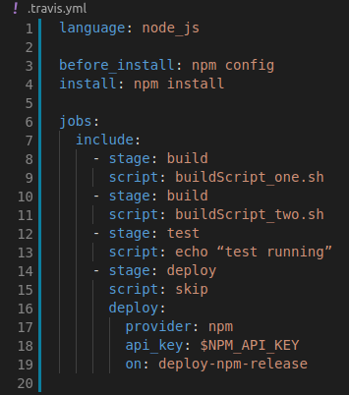
Job Lifecycle for Travis CI
.travis.yml
OPT Install apt addons
OPT Install cache components
before_install
install
before_script
script
OPT before_cache (for cleaning up cache)
after_success or after_failure
OPT before_deploy
OPT deploy
OPT after_deploy
after_script
main parts
more about: https://docs.travis-ci.com/user/job-lifecycle

Slide 8


Extensions of Continuous Integreation
Continuous
Integration (CI)
Continuous Delivery (CD)
Acceptance
Test
Deploy to
Staging
Deploy to
Production
Build
Test
Continuous Deployment (CD)
Deploy to
Production
Push code changes

Slide 9
Thank you! Questions?
dirk.riehle@fau.de – http://osr.cs.fau.de
dirk@riehle.org – http://dirkriehle.com – @dirkriehle
DR

Slide 10
Credits and License
Original version
  © Friedrich-Alexander University Erlangen-Nürnberg, all rights reserved
Contributions
  Julia Krause (2019)

